Slide 1
Physics Informed Neural Networks (PINNs) for Fixed-Bed Reactor Simulation
Mai Dinh Nam
Nguyen Phuc Luan
Thai Doan Kien

Slide 2
Outline
Introduction: Why we need PINNs?
Problem setup
Physics-Informed Neural Networks
Experiment Setup
Results
Assessment
Perspective
Conclusion

Slide 3
Outline
Introduction: Why we need PINNs?
Problem setup
Physics-Informed Neural Networks
Experiment Setup
Results
Assessment
Perspective
Conclusion

Slide 4
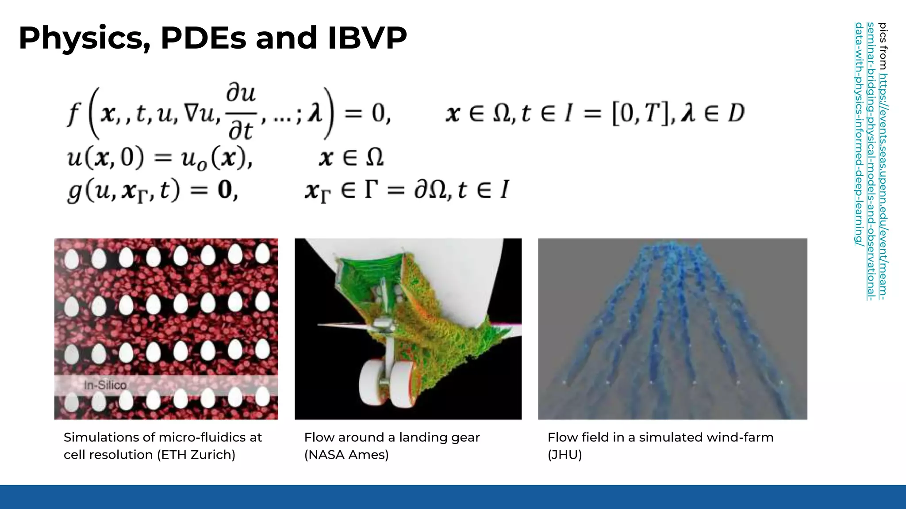
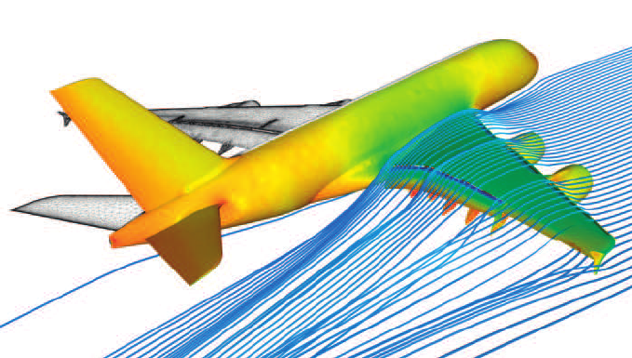
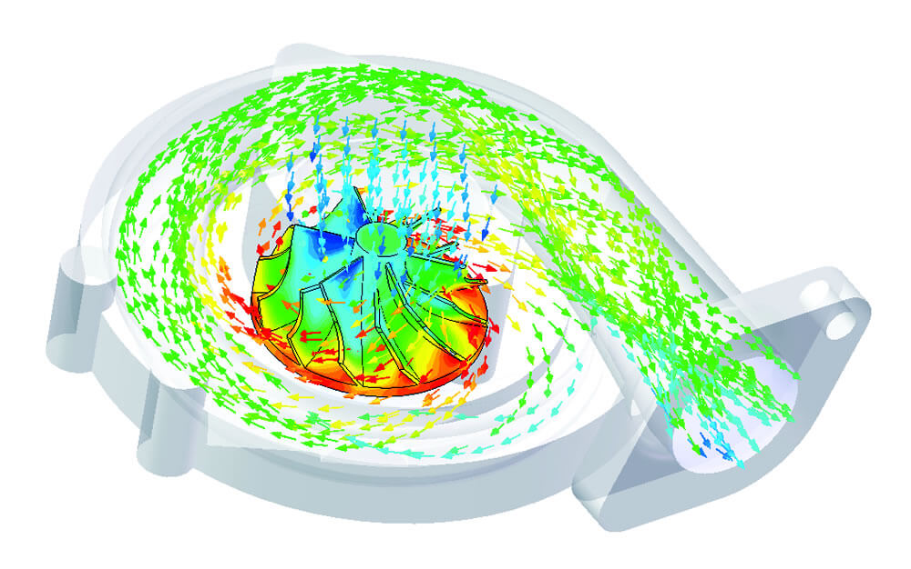
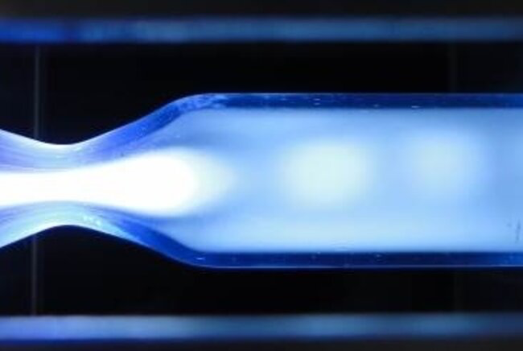
Numerical flow simulation for the Airbus A380
Fluid Flow Simulation
Low temperature Plasma Simulation

Slide 5
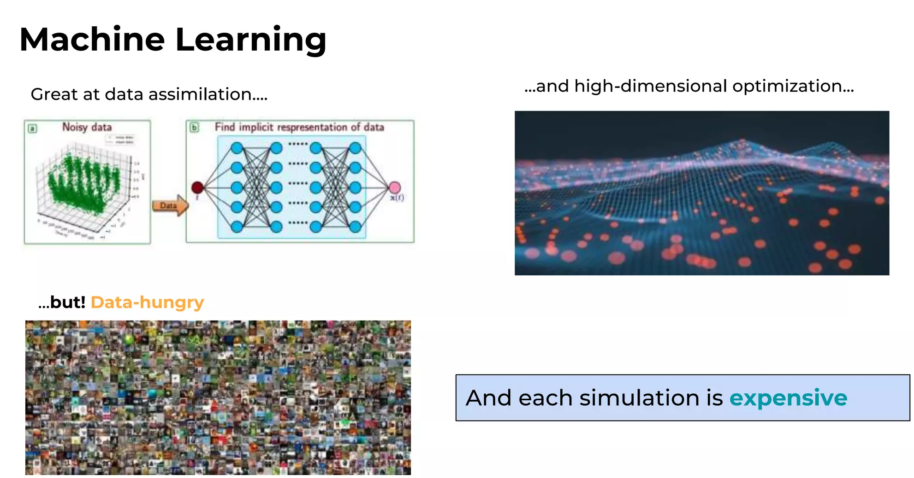

Slide 6
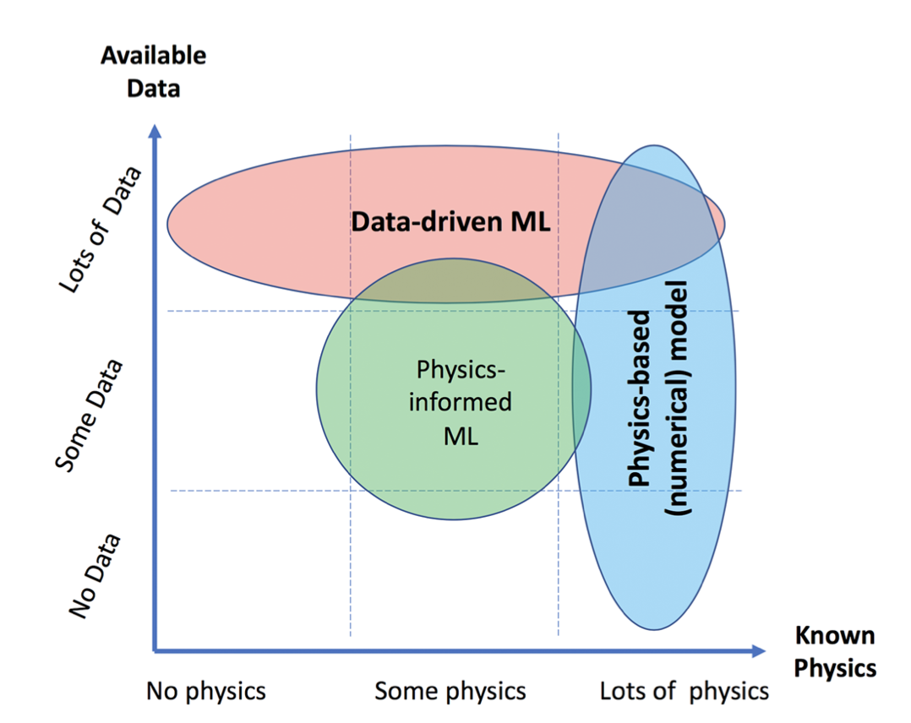
PINNs
source: 10.1029/2019WR026731

Slide 7
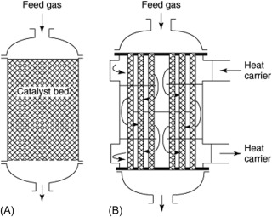
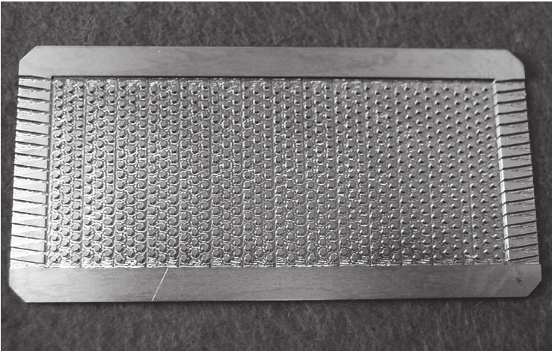
Catalytic Fixed-Bed Reactor
Adiabatic fixed-bed reactor (left) and multitubular fixed-bed reactor (right)
Multiple pin array of a fixed-bed reactor with 732 pins, diameter 0.8mm, height 0.8mm, distance in between 0.8 mm, machined in titanium grade 2 using a 0.6 mm micro end mill.

Slide 8
Outline
Introduction: Why we need PINNs?
Problem setup
Physics-Informed Neural Networks
Experiment Setup
Results
Assessment
Perspective
Conclusion

Slide 9
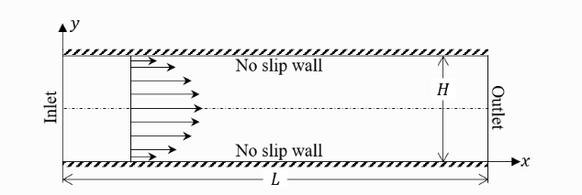
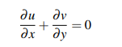
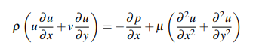
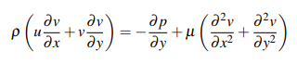
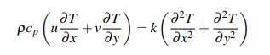
2.Problem setup
The assumptions and characteristics of the system
The flow is incompressible and steady-state
The fluid has constant properties dynamic viscosity µ, specific heat capacity cp, and thermal conductivity k
The system is not subject to any external forces or influences
D
Dimensional Navier-Stokes Equations in two dimensions (2D):
Continuity Equation:
Momentum Equations:
X-direction:
Y-direction:
Energy Equation:
Notes:
First, to model the problem, we made the following assumptions for the system. 1. meaning the fluid density is constant and the equations do not depend on time.
2. The fluid has constant properties, such as density ρ, dynamic viscosity µ, specific heat capacity cp, and thermal conductivity k
3. The system is not subject to any external forces or influences,including gravitational forces
From there, we established the system of Navier-Stokes equations in 2D space as shown above.

Slide 10
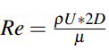
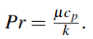
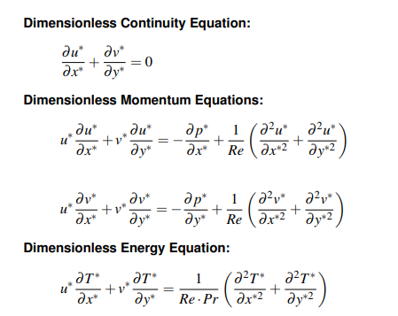
2.Problem setup
Dimensionless Navier-Stokes Equations
PINNs method substitutes estimates into the equations to calculate the total error of the system, which is then minimized
→ Without normalization, the optimization could be skewed toward minimizing the variables with the largest scales → Less accurate results for other variables
where
2D is the characteristic length,
U is the characteristic velocity,
∆T = TBC −Tin is the characteristic temperature difference
Reynolds number:
, Prandtl number
→ Normalizing the equations ensures that all variables have values within the range [0, 1] → More accurate minimization process
Notes:
PINNs method involves substituting estimates into the equations to calculate the total error of the system, which is then minimized
→ Without normalization, the optimization could be skewed toward minimizing the variables with the largest scales
→ Less accurate results for other variables
→ Normalizing the equations ensures that all variables have values within the range [0, 1]
→ More accurate minimization process Therefore, we reconstructed the dimensionless Navier-Stokes equations as shown on the right and will apply this system of equations to the following sections.

Slide 11
Outline
Introduction: Why we need PINNs?
Problem setup
Physics-Informed Neural Networks
Experiment Setup
Results
Assessment
Perspetive
Conclusion

Slide 12
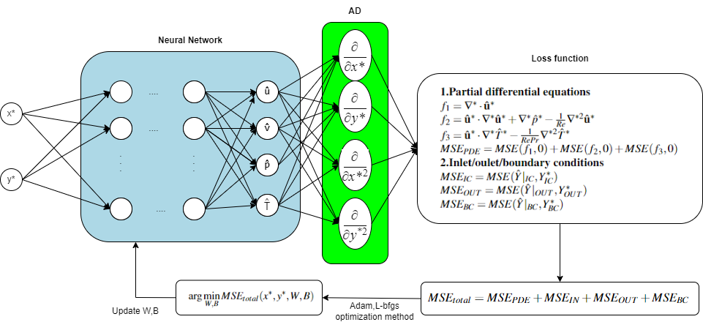
3. Physics-Informed Neural Networks
Notes:
Now I will explain the

Slide 13
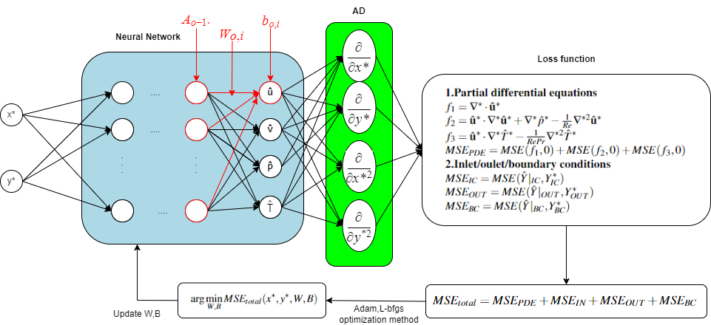
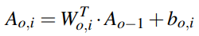
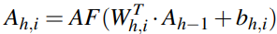
3. Physics-Informed Neural Networks
Forward Propagation
In the output layer:
In the hidden layer:
activation function (tanh)

Slide 14

3. Physics-Informed Neural Networks
Automatic differentiation

Slide 15
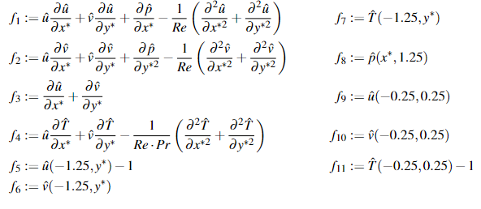

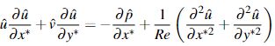
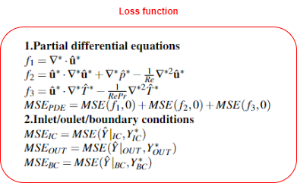
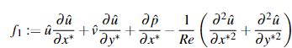
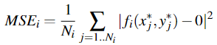
3. Physics-Informed Neural Networks
Loss functions
For example:
Loss function:

Slide 16

3. Physics-Informed Neural Networks
Total loss

Slide 17
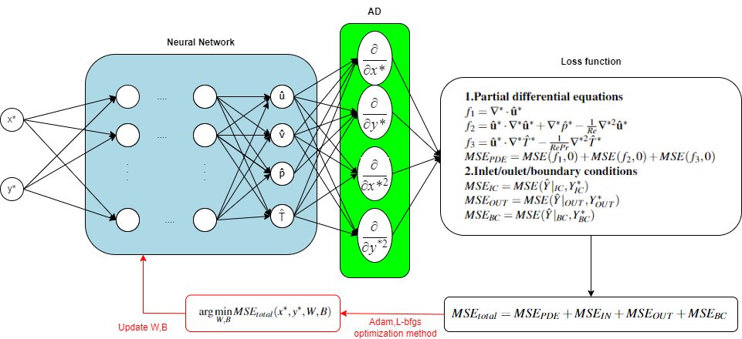
3. Physics-Informed Neural Networks
Backward propagation

Slide 18
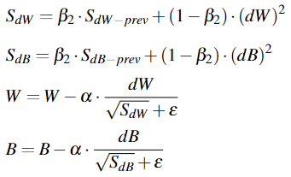
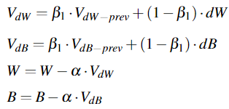
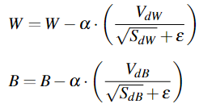
3. Physics-Informed Neural Networks
Adam optimization method
RMSprop
Momentum
fast convergence
Adam
more stable convergence
β1 = 0.9
β2 = 0.999
ε = 1e−7

Slide 19
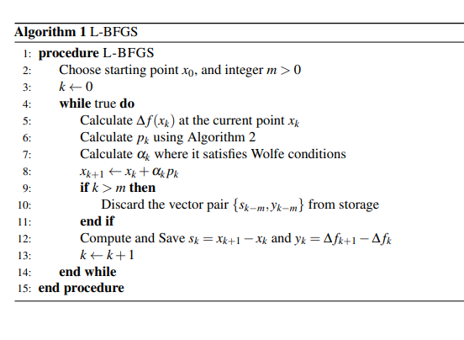
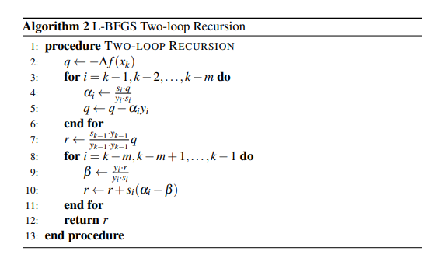
3. Physics-Informed Neural Networks
Optimization method
L-BFGS
An optimization algorithm in the family of quasi-Newton methods
(approximation of the inverse of the Hessian matrix)
Based on the Broyden–Fletcher–Goldfarb–Shanno algorithm (BFGS) but using a limited amount of computer memory
Notes:
An optimization algorithm in the family of quasi-Newton methods
(approximation of the inverse of the Hessian matrix)
We use LBFGS after Adam's method because the common drawback of Newton methods is that they depend on the initial initial point and therefore may not converge to the global minimum point. Based on the Broyden–Fletcher–Goldfarb–Shanno algorithm (BFGS) but using a limited amount of computer memory.

Slide 20
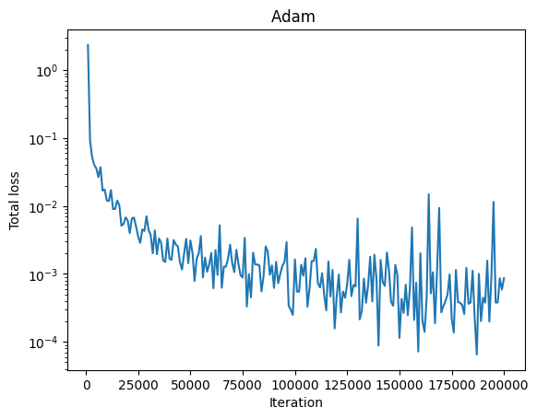
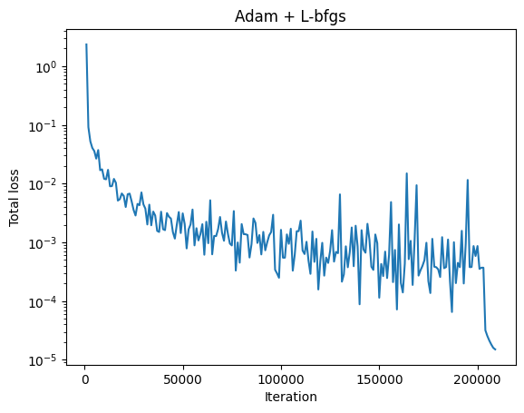
3. Physics-Informed Neural Networks
Optimization method
Adam converges quickly towards the global minimum, but it oscillates around [e-3,e-4] and does not decrease further.
L-BFGS can decrease deeply but can fall into local minimum if we use it from the beginning.
By combining Adam as an initial optimization algorithm, then continuing with L-BFGS, we will have better optimal results.

Slide 21
Outline
Introduction: Why we need PINNs?
Problem setup
Physics-Informed Neural Networks
Experiment Setup
Results
Assessment
Perspective
Conclusion

Slide 22
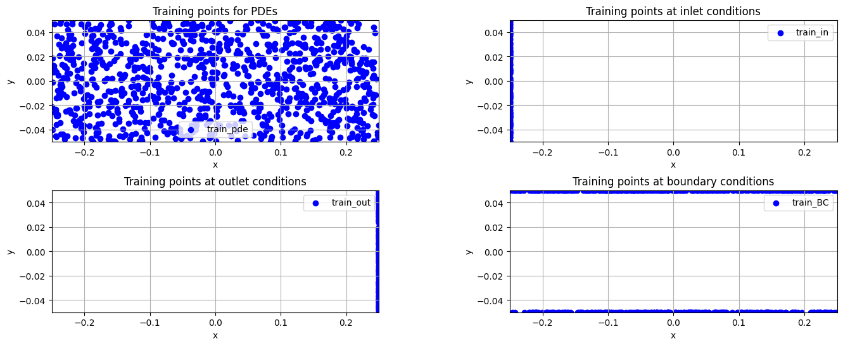
4. Experiment Setup
Training points

Slide 23
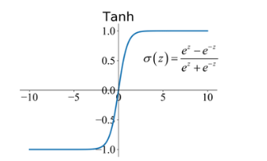
4. Experiment Setup
Choose the activation function
The Hyperbolic Tangent Activation Function (tanh)
Maps input values to a range between -1 and 1, helping normalize data and facilitating effective training by avoiding issues with unbalanced gradients
Provides stronger gradients for inputs near zero aiding efficient training.

Slide 24
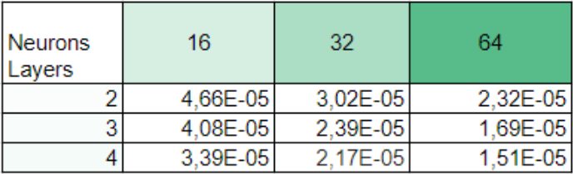
4. Experiment Setup
Choose the number of hidden layers and neurons
→ We choose 4 hidden layers with 64 neurons per hidden layer to give us the best results.

Slide 25
Outline
Introduction: Why we need PINNs?
Problem setup
Physics-Informed Neural Networks
Experiment Setup
Results
Assessment
Perspective
Conclusion

Slide 26
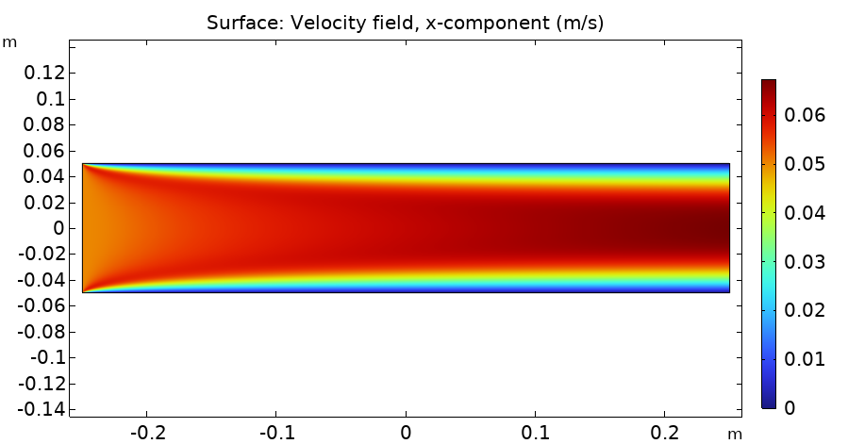
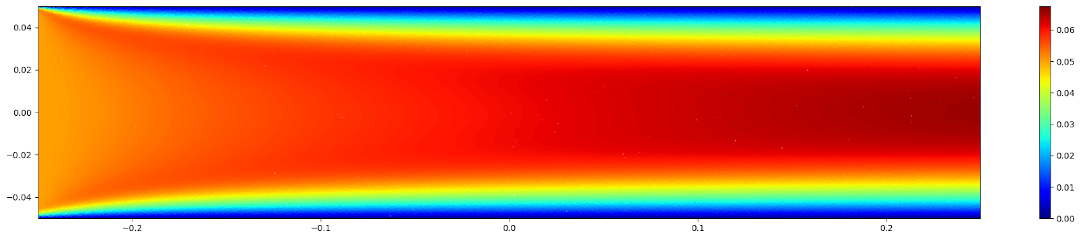
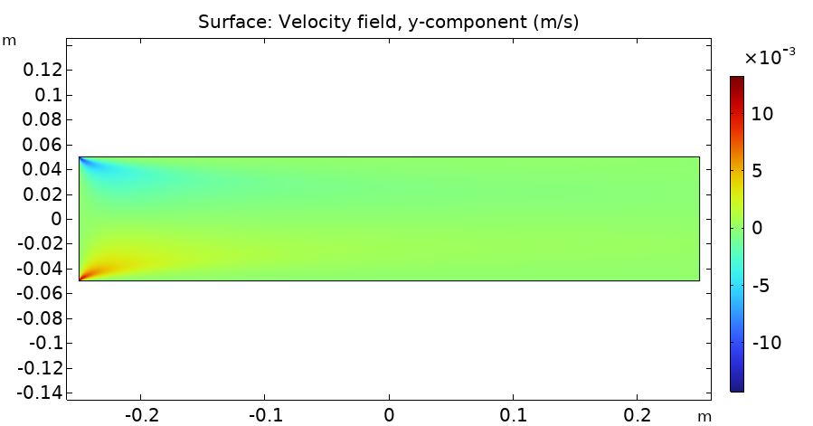
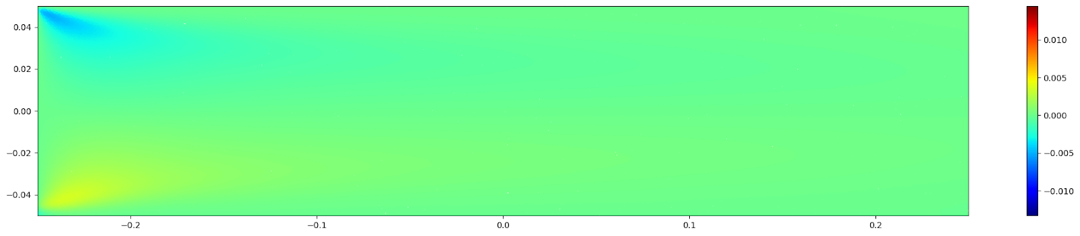
5.Result
CFD
PINNs
Notes:
Both results exhibit a similar overall shape
Velocity u: The highest velocity (red) is concentrated in the center, gradually decreasing towards the plates (blue) and reaching zero at the two plates. The velocity u between the plates in the PINNs model is slightly lower (indicated by a lighter red) compared to the CFD.
• Velocity v: v=0 at almost every point except the 2 inlet corners. In the bottom left corner, corresponding to the corner of the lower plate and the inlet, the velocity v in the PINNs model is lower (lighter yellow) compared to the CFD.
• Pressure p: Similarly, in the two corners at the inlet, the pressure p in the PINNs model is lower compared to the CFD .

Slide 27
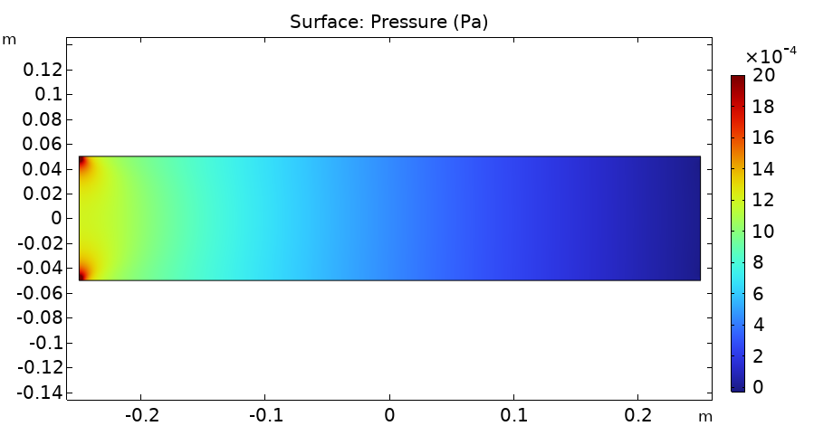
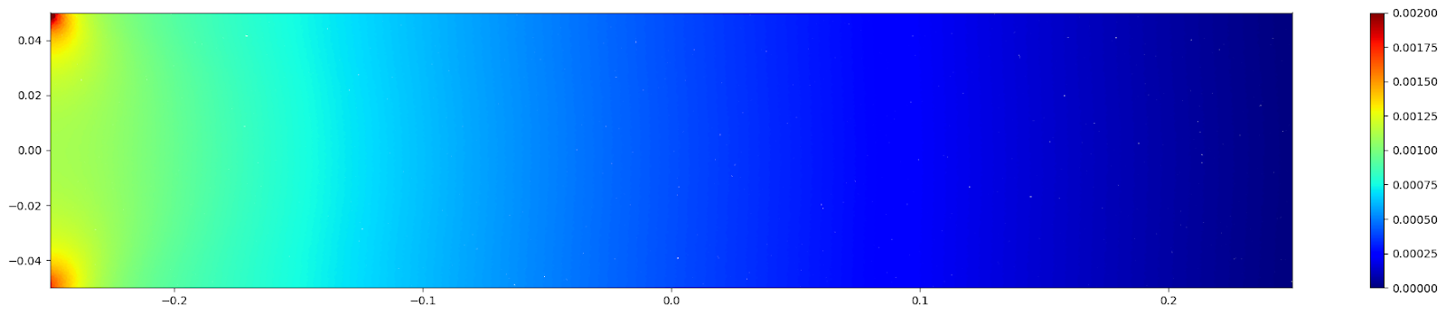
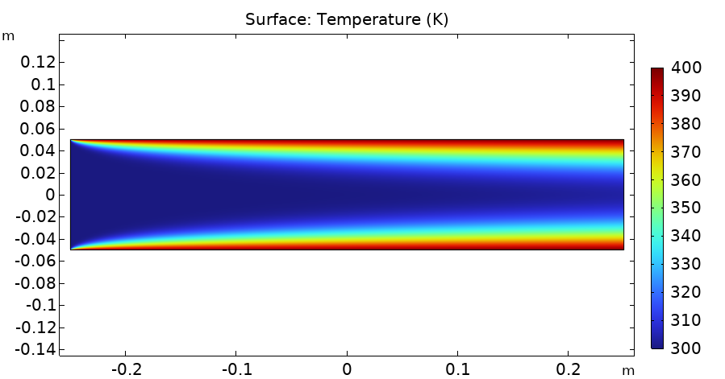
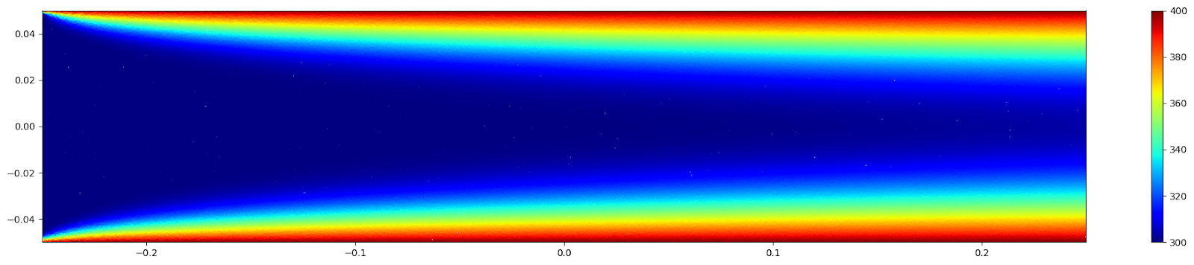
5.Result
CFD
PINNs

Slide 28
5.Result
Interpretation
Similar overall flow patterns and trends observed.
Some differences in detailed velocity and pressure fields.
PINNs model indicates slightly lower values in certain regions compared to CFD.
Despite differences, error is small and acceptable.
=>PINNs effectively solve Navier-Stokes and heat balance equations in this case.
Notes:
From the results we can make the following comments.

Slide 29
Outline
Introduction: Why we need PINNs?
Problem setup
Physics-Informed Neural Networks
Experiment Setup
Results
Assessment
Perspective
Conclusion

Slide 30
6.Assessment
Objectives achieved:
Integration of Physics and Neural Network.
Accuracy of Predictions.
Difficulties and challenges:
No real data.
The difference in value between loss functions.
Only using the Adam optimization method as a model does not have high accuracy.
Solution:
Use dimensionless formula to reduce the difference in values ​​between loss functions.
Add L-bfgs optimization method to optimize the model better.

Slide 31
Outline
Introduction: Why we need PINNs?
Problem setup
Physics-Informed Neural Networks
Experiment Setup
Results
Assessment
Perspective
Conclusion

Slide 32
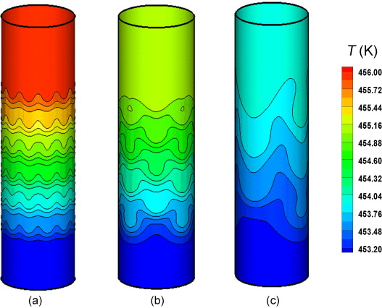
7.Perspective
Experiment with 3D models, time-dependent problems, change to another type of liquid,...
Expand the model to apply to other problems.
Improve accuracy by researching better optimization methods.
3D CFD model: Fixed-bed reactor
source: https://doi.org/10.1016/j.partic.2012.10.009

Slide 33
Outline
Introduction: Why we need PINNs?
Problem setup
Physics-Informed Neural Networks
Experiment Setup
Results
Assessment
Perspective
Conclusion

Slide 34
8.Conclusion
PINNs method showcases its potential in simulating fluids mechanic problems
Advantages of the method:
Data not required
Cost effective simulation
Alleviate the curse of dimensionality
Drawbacks:
Translation and discontinuous behavior are hard to approximate using PINNs

Slide 35
Thanks for your attention!
Mai Dinh Nam
Nguyen Phuc Luan
Thai Doan Kien

